Slide 1
Amazon Product Review Analysis
for
Luxury Beauty and All Beauty
Presented by :-
Atul Kumar
Manthan Jagdale
Sai Vara Prasad

Slide 2
Objective
Identifying reviews as positive, negative and neutral (Sentiment analysis).
Optimization of inventory by identifying the products in demand (Stocks management).
Demand forecasting based on customer sentiments.
Source of Data
Dataset | Number of reviews | Year of reviews | size
All Beauty | 371,345 | 2004-2018 | 226 mb
Luxury Beauty | 574,628 | 2001-2018 | 330 mb

Slide 3
Description of Data
Review Datasets:-
Metadeta :-
Column | Description
reviewerID | ID of the reviewer
asin | D of the product
reviewerName | name of the reviewer
vote | helpful votes of the review
style | a disctionary of the product metadata
reviewText | text of the review
overall | rating of the product
summary | summary of the review
unixReviewTime | time of the review (unix time)
reviewTime | ime of the review (raw)
image | images that users post after they have received the product
Column | Description
title | name of the product
asin | D of the product
feature | bullet-point format features of the product
description | description of the product
price | price in US dollars (at time of crawl)
imageURL | URL of the product image
related | related products
salesRank | sales rank information
brand | brand name
categories | list of categories
tech1 | the first technical detail table of the product
tech2 | the second technical detail table of the product
similar | similar product table

Slide 4
Graphical Business Insights and observations

Slide 5

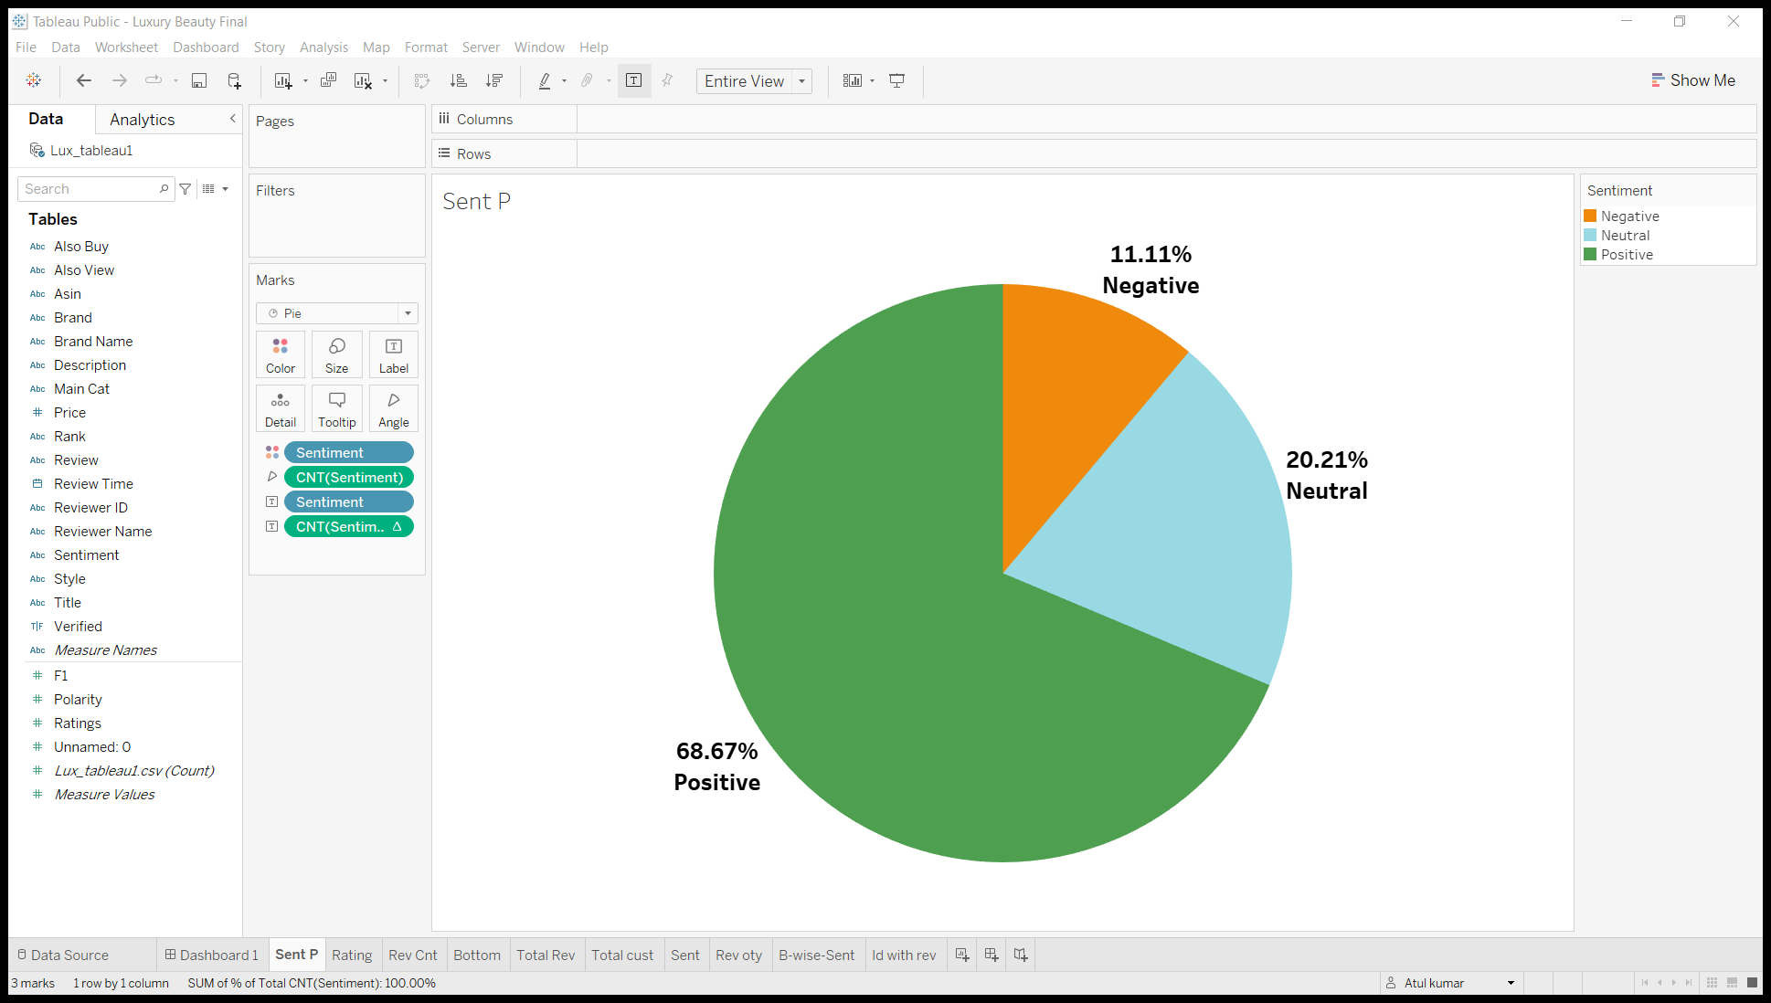
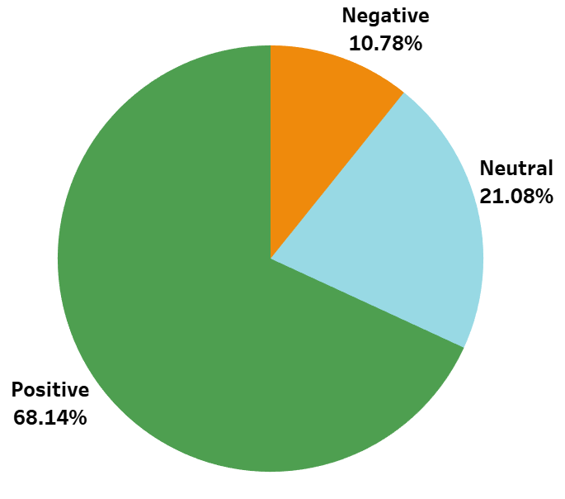
Proportion of review type
Luxury Beauty
All Beauty
In both the categories positive reviews are more as compared to the negative and neutral reviews

Slide 6
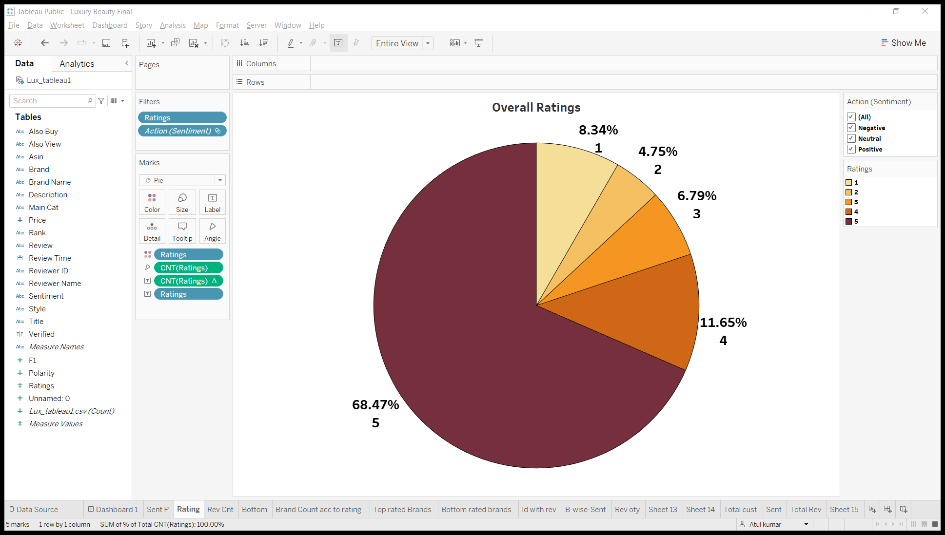
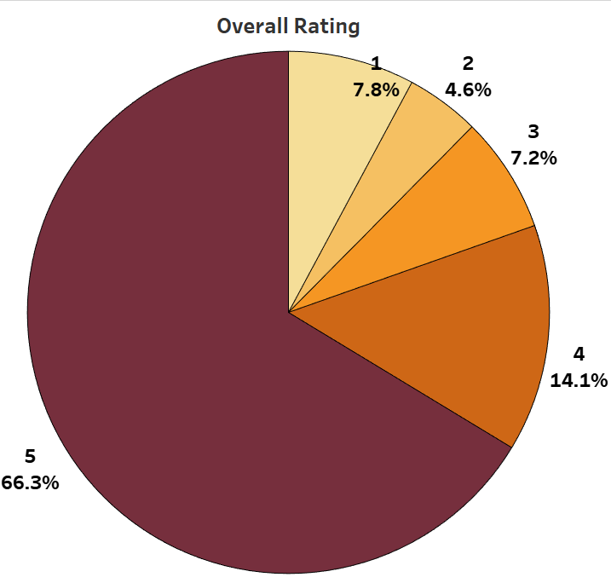
Overall Ratings Proportion
Luxury Beauty
All Beauty
5 Star had been given by most reviewers
2 Star had been given by least reviewers
5 Star had been given by most reviewers
2 Star had been given by least reviewers
In both of the dataset the proportion of rating is nearly same

Slide 7
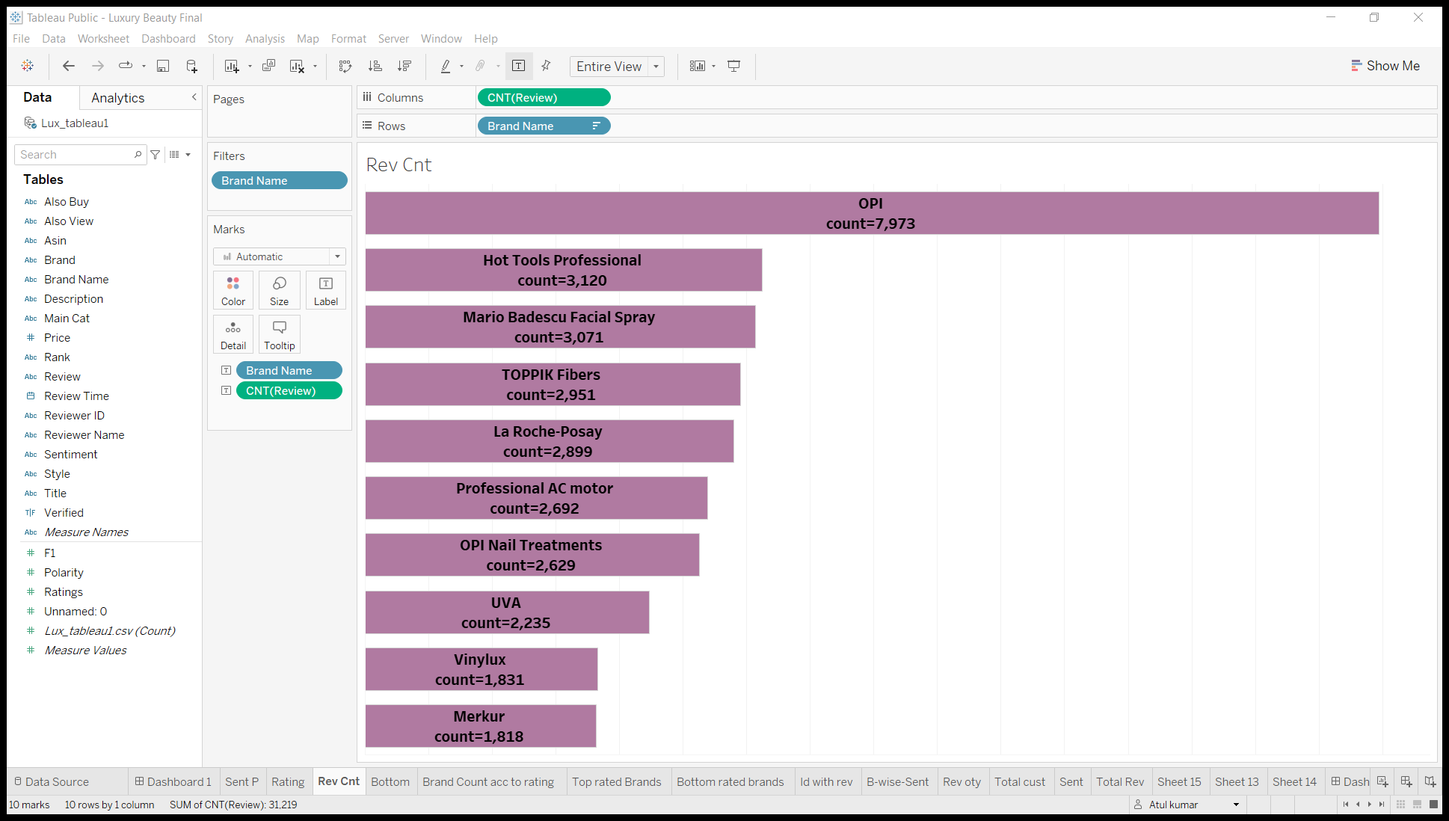
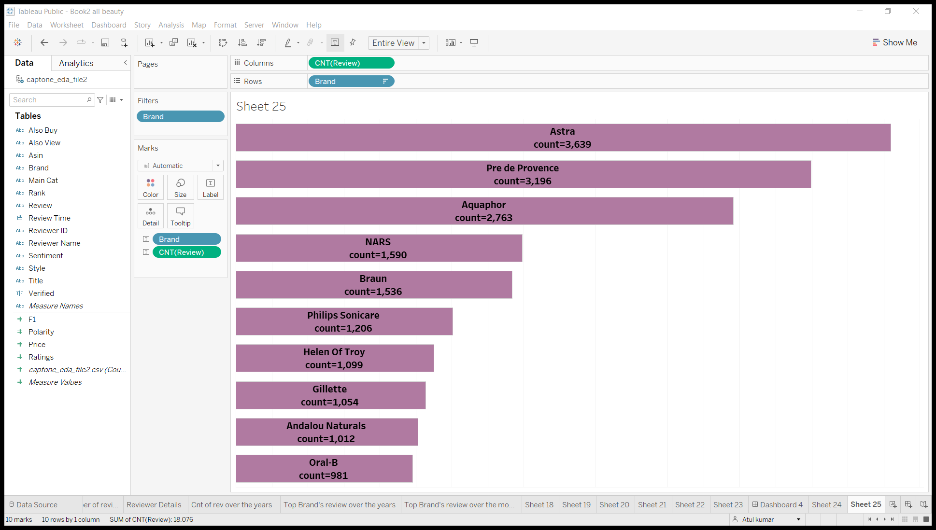
Top 10 brands with most number of reviews
Luxury Beauty
All Beauty

Slide 8
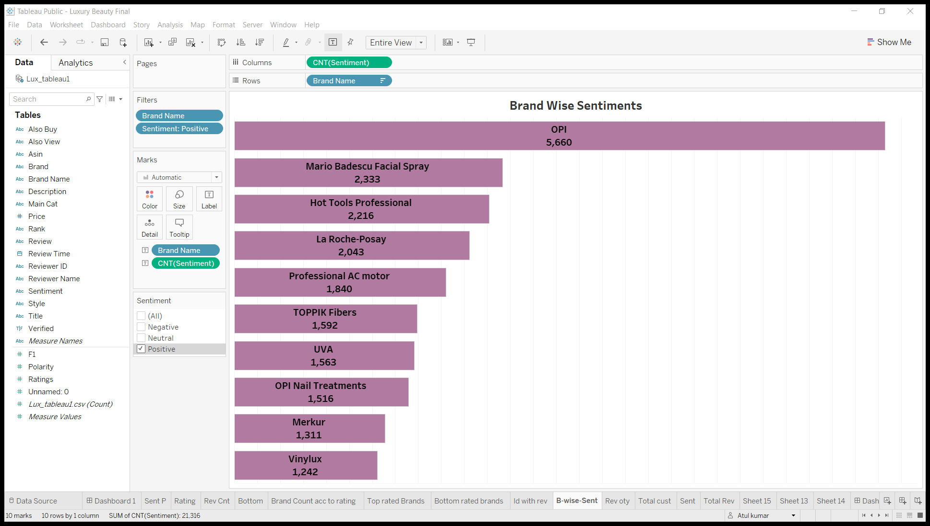
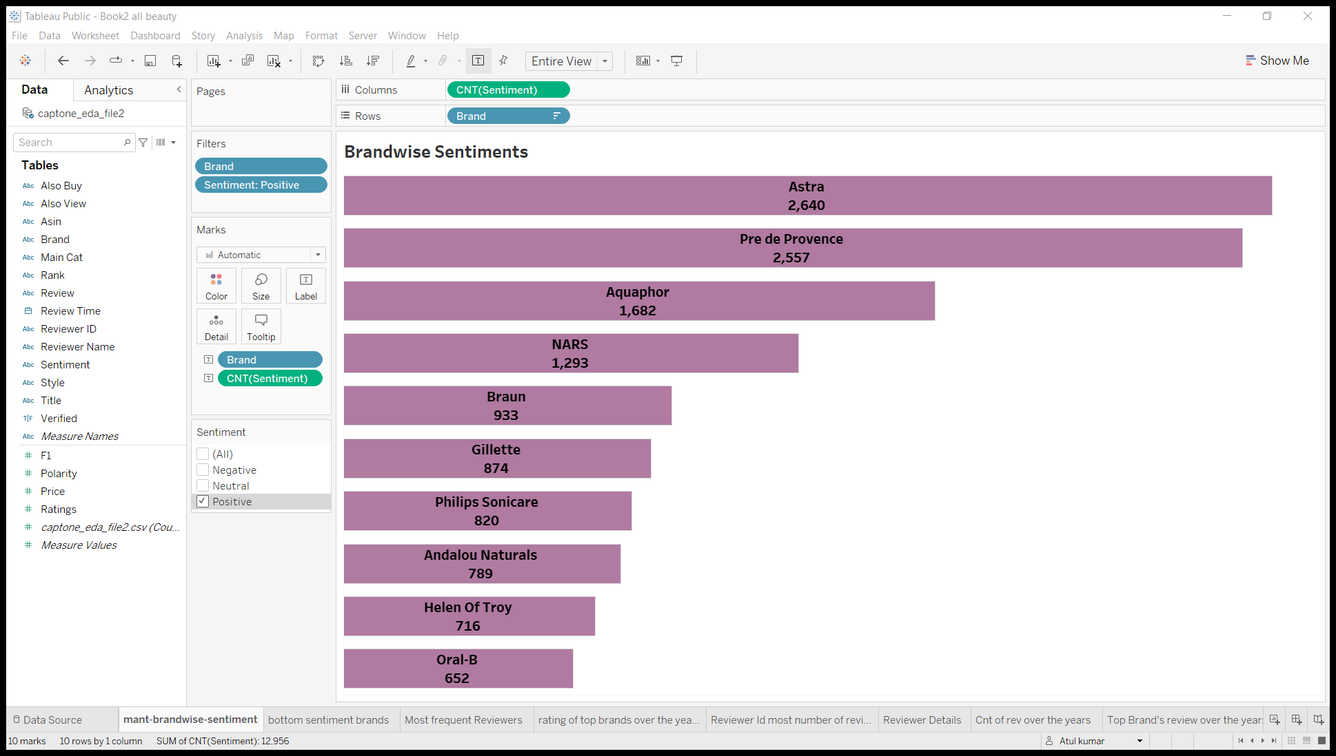
Brands with most number of reviews with respect to positive reviews
Luxury Beauty
All Beauty

Slide 9
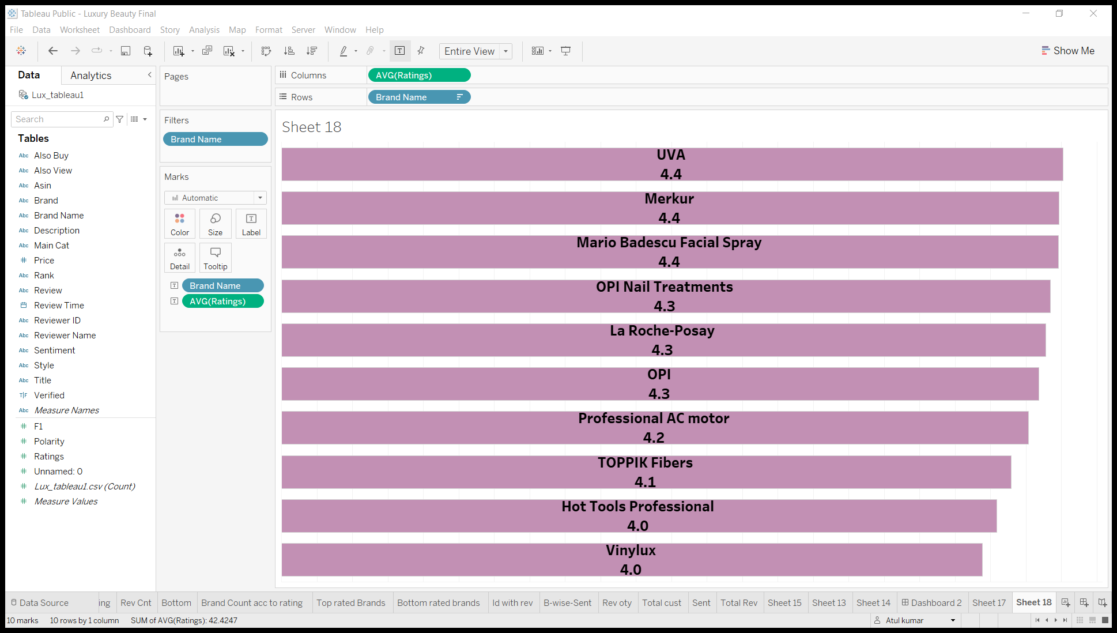
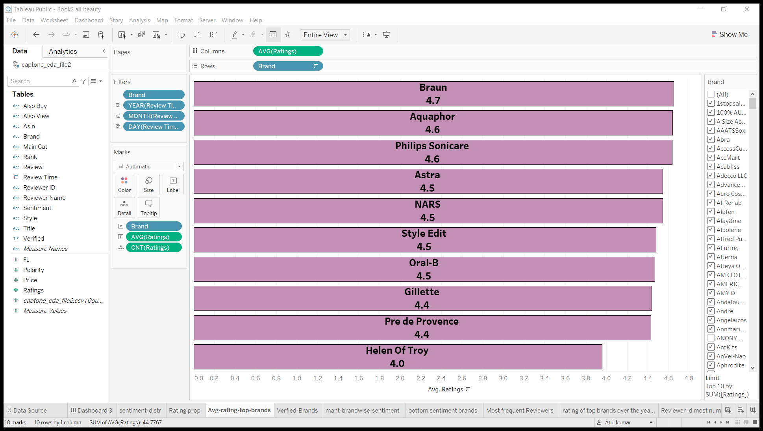
Average rating of the top 10 identified brands
Luxury Beauty
All Beauty

Slide 10
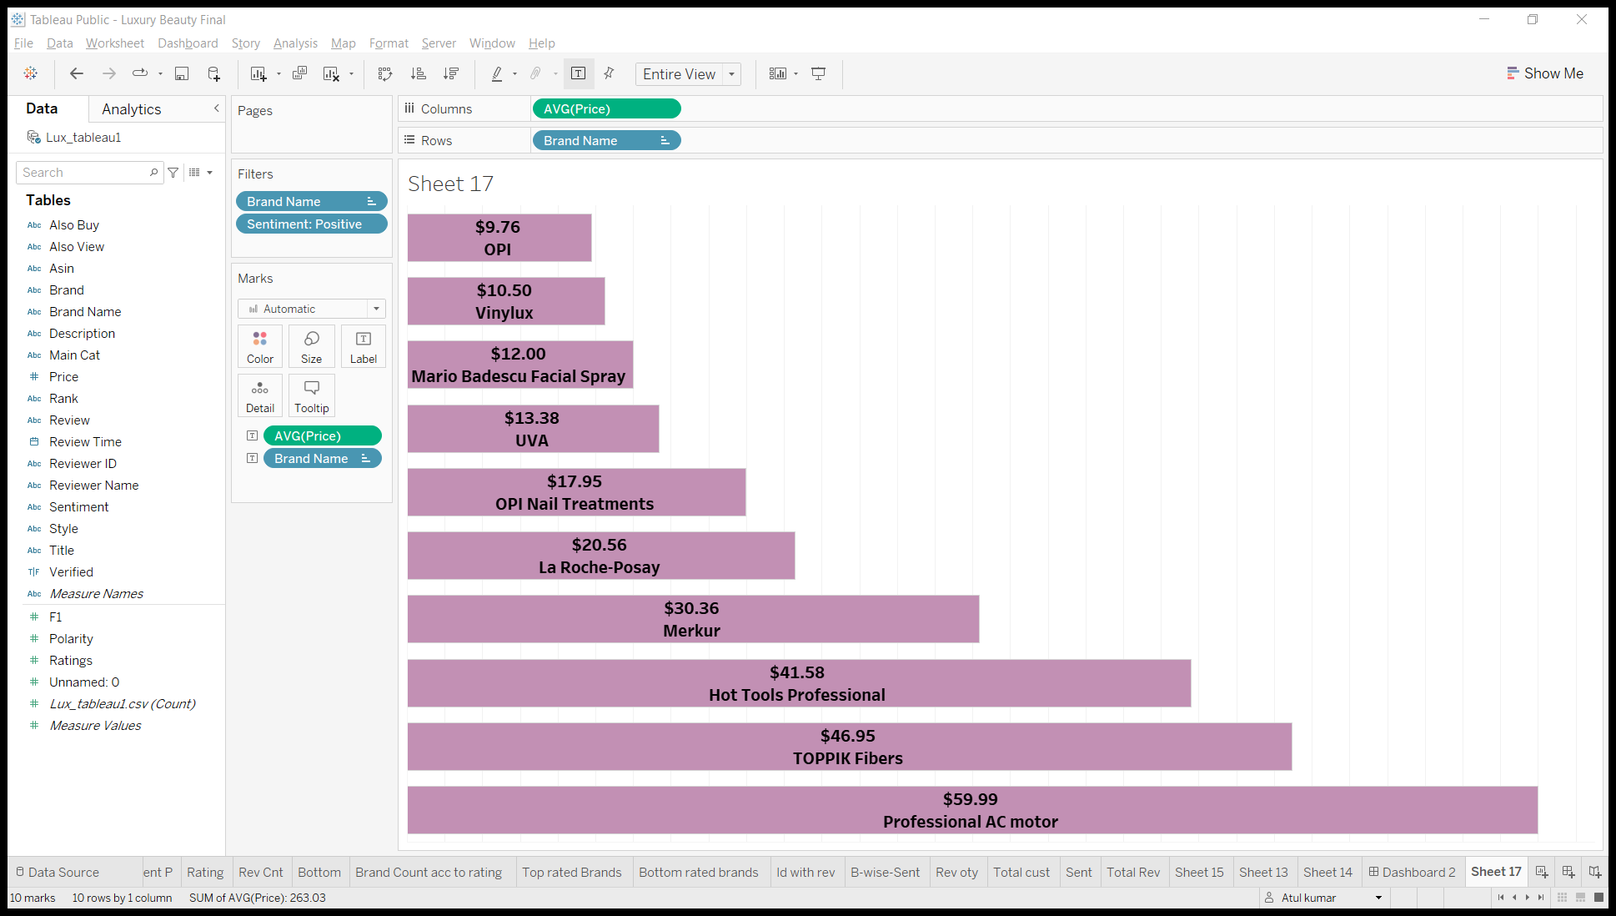
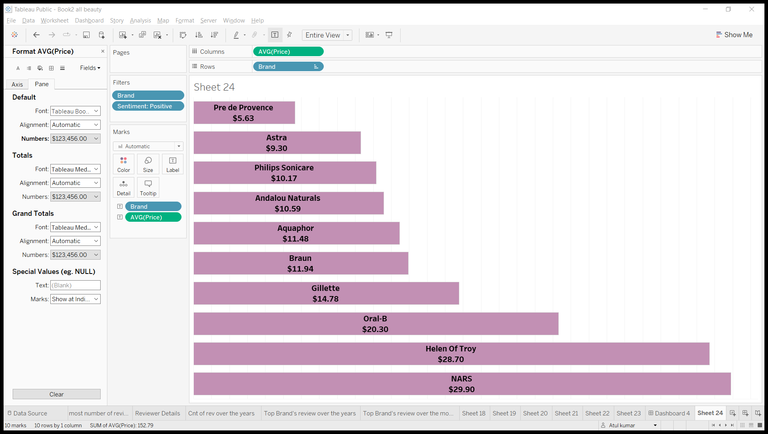
Average price of top 10 identified brands
Luxury beauty
Avg price=$33.1
All beauty
Avg price=$17.13

Slide 11
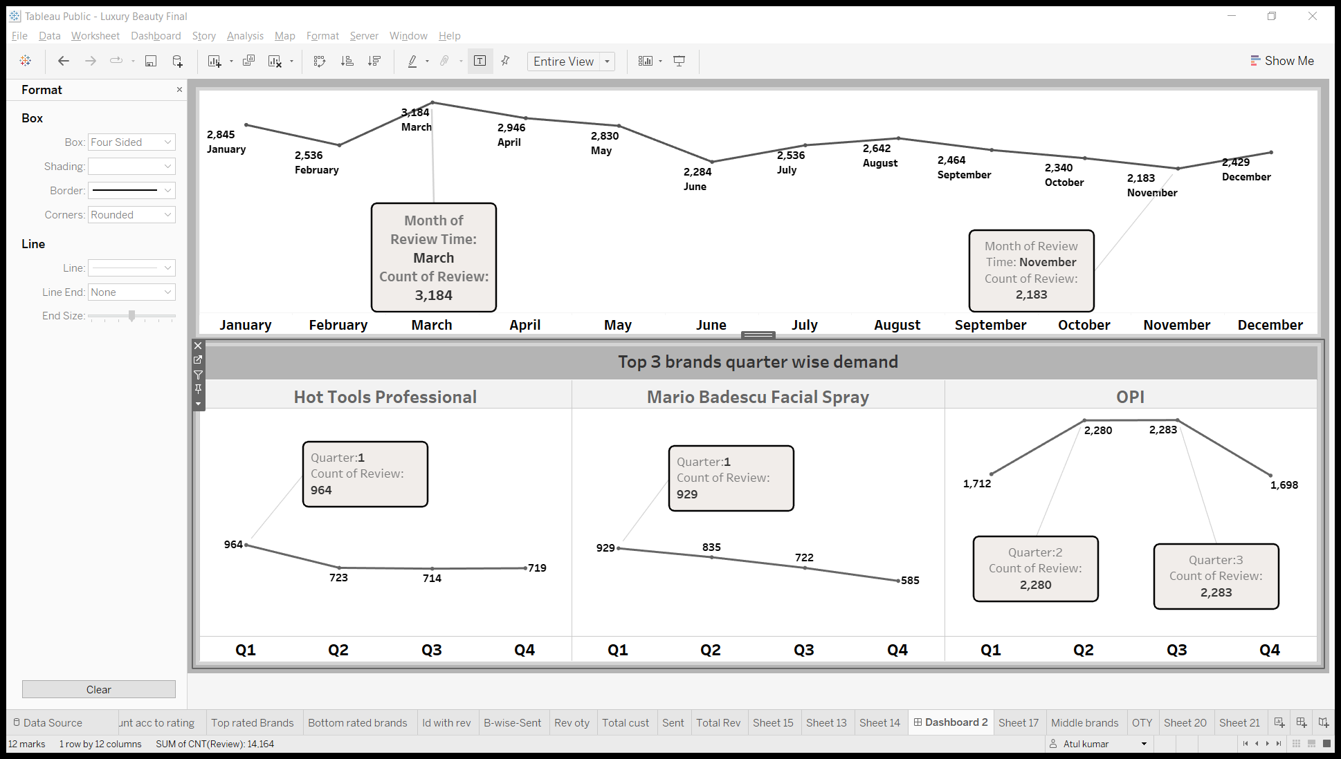
Count of review of top 10 brands over the months in Luxury dataset

Slide 12
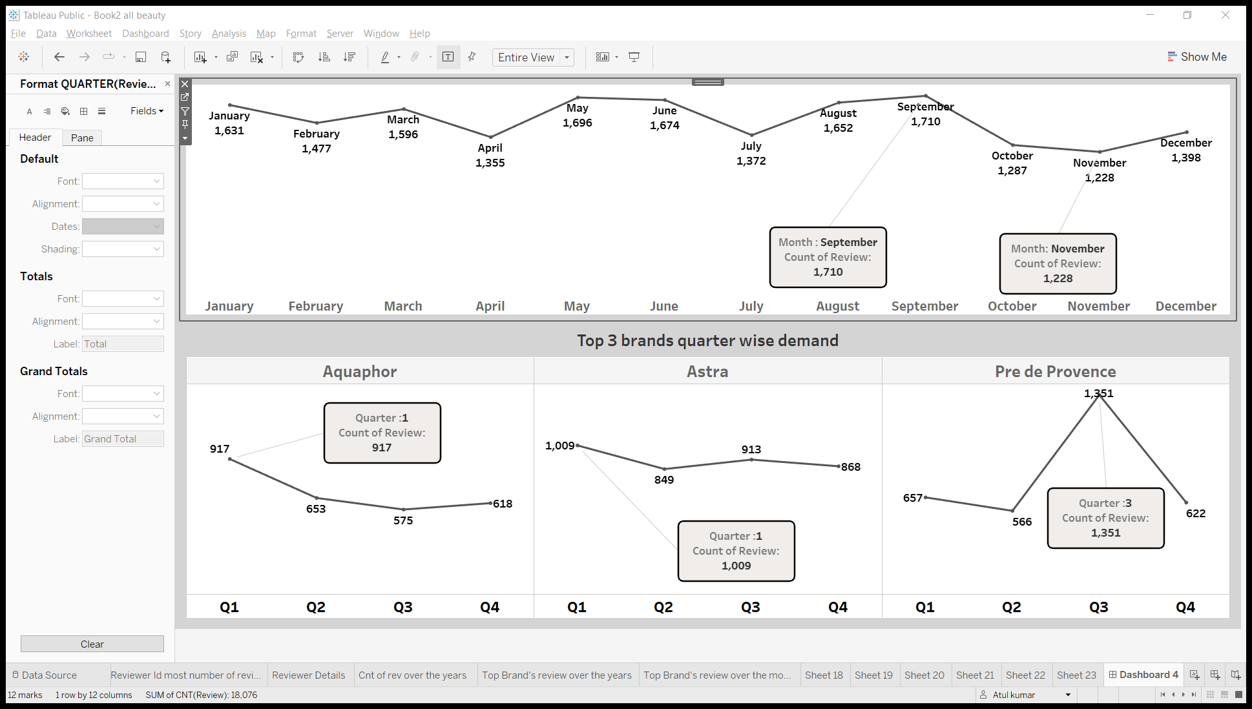
Count of review of top 10 brands over the months in All beauty dataset

Slide 13
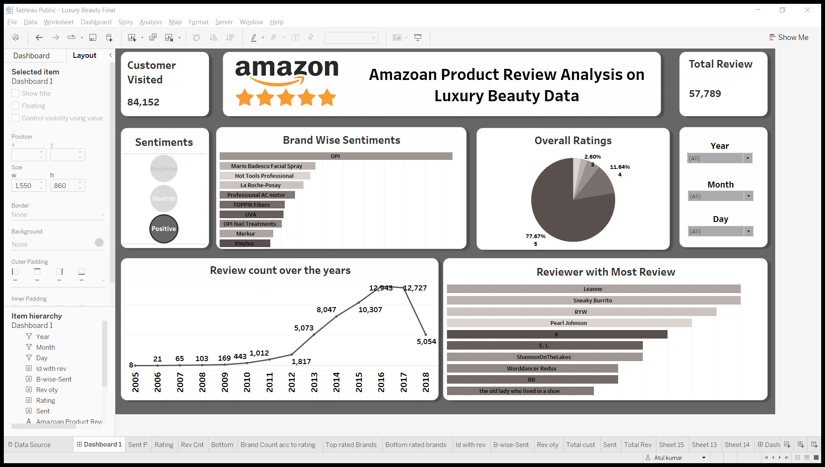
Dashboard
To see the dashboard->
Dashboard Link
{All Beauty}
To see the dashboard->
Dashboard Link
{Luxury Beauty}

Slide 14
Time series analysis of customer reviews(Future prediction of type of customer review )

Slide 15
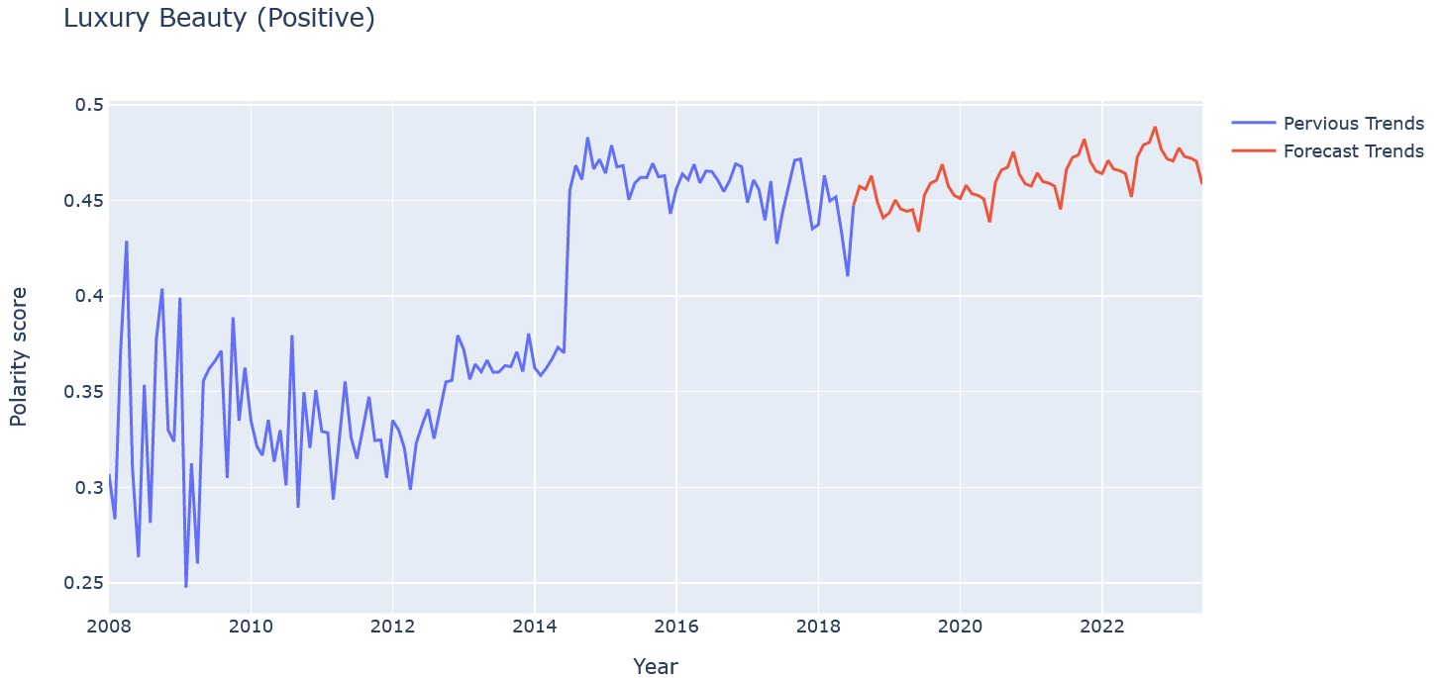

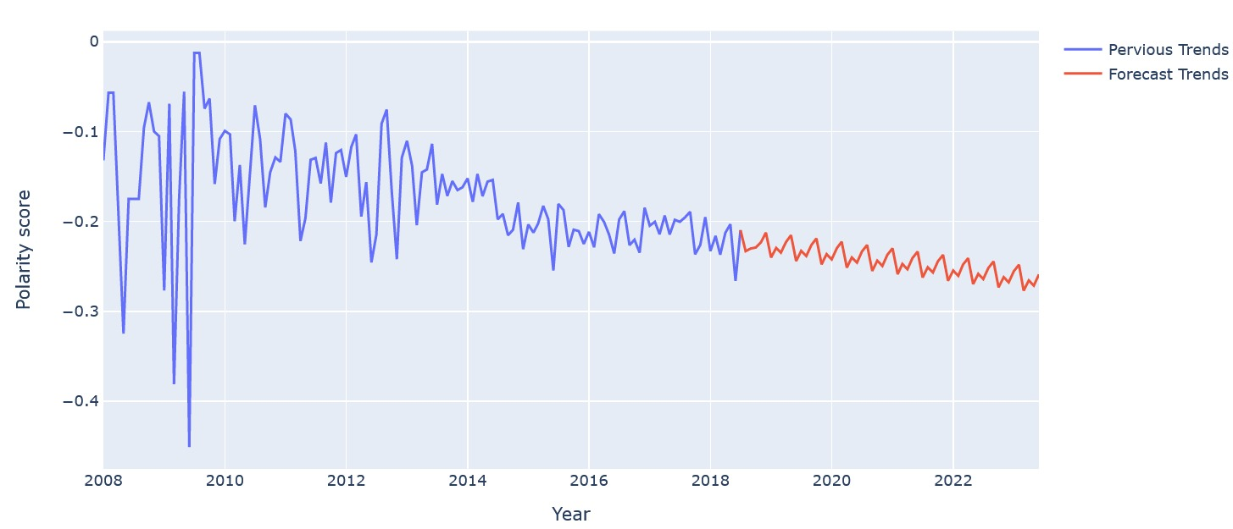
Luxury Beauty review type Forecast
Positive reviews of customer buying Luxury beauty products are expected to increase.
Negative review of customer buying Luxury beauty products are also expected to increase.
Negative

Slide 16
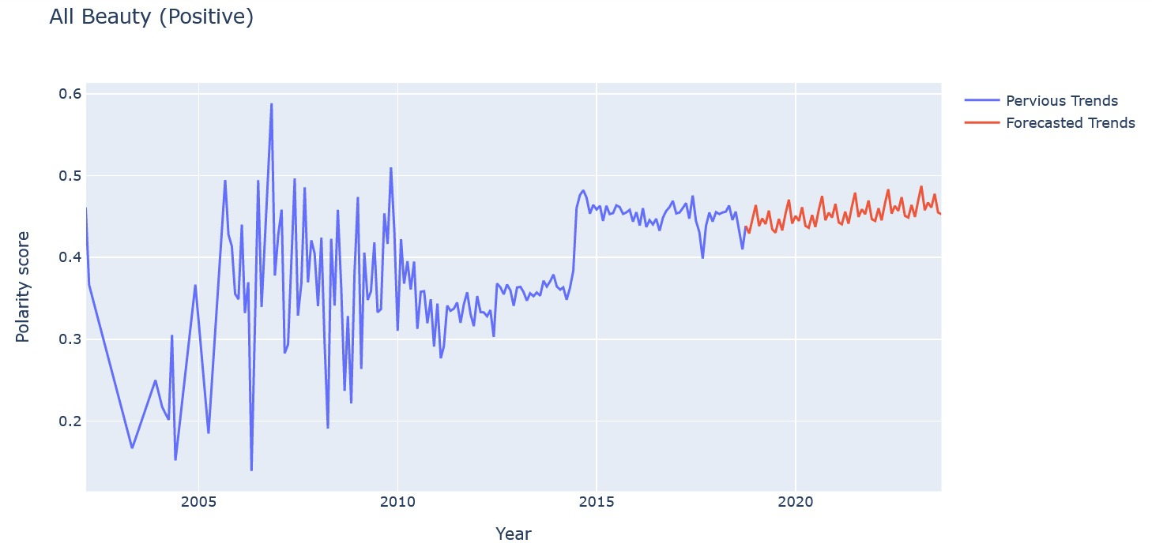
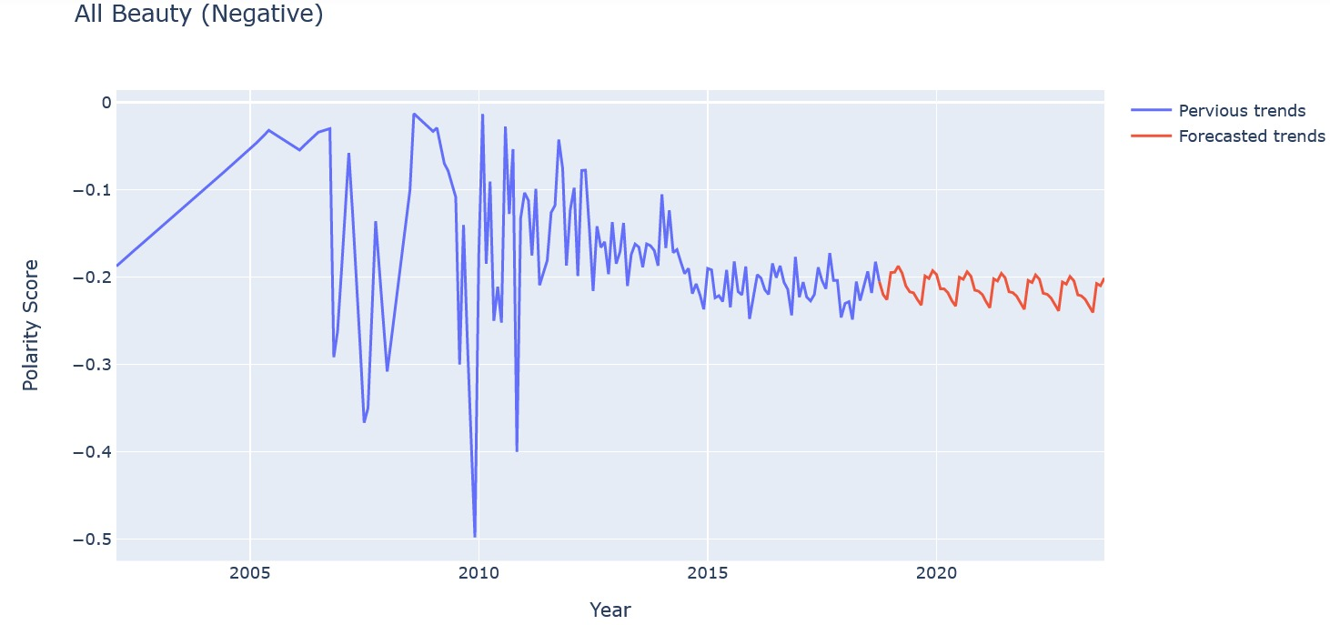
All Beauty review type Forecast
Positive reviews of customer buying All beauty products are expected to increase steadily.
Negative reviews of customer buying All beauty products are expected to stay moreover constant.
Negative

Slide 17
Technical Analysis
Models used and their performances
Time Series analysis Results:-
Dataset | Sentiments | Model Used | RMSE | MSE
Luxury beauty | Positive | SARIMA | 0.05358 | 0.00286
 | Negative | SARIMA | 0.02437 | 0.00059
All Beauty | Positive | SARIMA | 0.03111 | 0.00096
 | Negative | SARIMA | 0.02801 | 0.00078
Library used for sentiment analysis:-
Text Blob
Input- Review text
Output- Polarity score and subjectivity score.
Range[-1 to 1] for polarity and [0 to 1] for subjectivity.

Slide 18
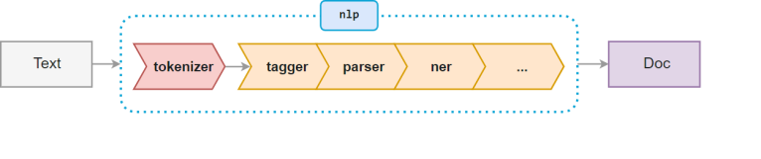
Problem in luxury beauty dataset:-
In luxury beauty we had approximately 99% empty string in the column ‘brand’.
Replacing them with any statistical measure would have caused unnecessary biasness in the data.
To overcome this problem we used NER (Named Entity Recognition) in which we derived the brand name from description of the product by identifying the organization(org) name.

Slide 19
Business Insights
Positive sentiment reviews are more in number than negative sentiment reviews.
Reason for review type:-
Positive:-Good quality, good packaging, receive compliments ,comfortable, amazing smell, moisturizes well, even textured, soft touch, long-lasting.
Negative:-Costly, awful, products is not same as expected, less quantity, poor quality,
dull, sticky, waste of money ,bad packaging.
Demand for top performing brands is expected to increase.
Category | Top 3 identified brands | Approach | Stock management
Luxury beauty | OPI (Nail care/ Polish Mario Badescu facial spray Hot Tools Professional(hair curling iron | These 3 brands have nearly 50% of review in top 10 brands | Most demanded in Quarter-2 and Quarter-3 Most demanded in Quarter-1 Most demanded in Quarter-1
All beauty | Astra (Razor) Aquaphor(Healing Ointment) Pre de province(soap) | These 3 brands have nearly 50% of review in top 10 brands | Most demanded in Quarter-1 Most demanded in Quarter-1 Most demanded in Quarter-3

Slide 20
For better optimization of inventory:-
For luxury beauty category, we are getting most review in month of march so as we approach the month of march we can increase the stocks of luxury beauty products.
For All beauty category, we are getting most review in month of September so as we approach the month of September we can increase the stocks of luxury beauty products.
As the customer engagement(number of reviews) is increasing we observed that average price is also decreasing for top 10 products, so we can say that to increase sales reduction in average price of products can be an advantage.
Thank You

